Slide 1

DEEPFAKE DETECTION USING DEEP LEARNING
TEAM MEMBERS:
NADIGOTTU DIVYA SREE | 2203A51023
MYAKALA CHANDANA | 2203A51086
GUMPULA VYSHNAVI | 2203A51174
BEERAM PRANATHI | 2203A51274
UPPU SPANDANA | 2203A51456
Guide: Dr. M. Shashikala
Institution: SR University, Warangal

Slide 2
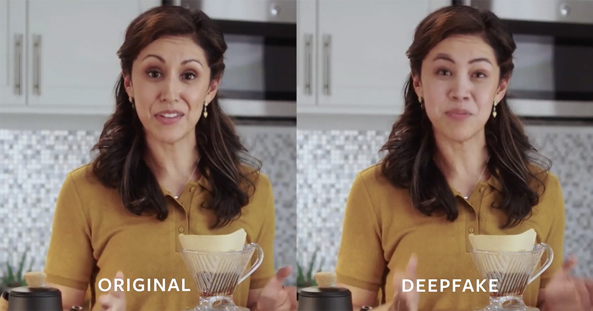
Slide Title
Introduction
The Deepfake Crisis:
Deepfakes are rapidly increasing across social media and digital platforms
Pose major threats to privacy, security, and information authenticity
Urgent need to control misuse due to rising global digital dependence
Current Limitations:
Manual verification of media is slow and inefficient.
Reactive actions only after misinformation spreads.
Traditional detection methods cannot handle complex manipulations.
Delayed decision-making due to lack of automated tools.
The Need:
AI-driven system for proactive deepfake detection.
Deep learning to accurately classify real vs fake content.
Real-time detection support for users and authorities.
Our Mission:
“Strengthen digital trust by detecting deepfakes through advanced deep learning intelligence.”

Slide 3
Slide Title
Problem statement
Deepfake media has become a serious global digital security concern, creating major risks related to misinformation, privacy violations, financial fraud, and reputational damage. The increasing realism and complexity of deepfakes make timely identification and prevention extremely challenging.
Major Public Safety Issue:
Leads to misinformation, privacy threats, financial fraud, and reputational damage.
Lack of Timely Tools:
Authorities and users lack fast, AI-based systems to identify deepfakes instantly.
Multifactorial Dependency:
Deepfake detection is affected by multiple factors, including facial variations, lighting conditions, video quality, and advanced manipulation techniques.
Inefficient Manual Analysis:
Human inspection is slow, unreliable, and cannot keep up with the massive volume of online images and videos.

Slide 4
Slide Title
Proposed Solution
A Deep Learning Approach for Deepfake Detection
Data Integration and Preprocessing:
Frames are extracted from real and fake videos in the FaceForensics++ dataset.
Faces are detected using Haarcascade, then resized, normalized, and augmented for training.
2. Exploratory Data Analysis (EDA):
Analysis is performed to observe differences between real and fake images.
Includes visualizing facial artifacts, texture variations, and compression effects.
3. Model Development and Training:
A deep learning model (ResNet18 with transfer learning) is trained for binary classification.
Fine-tuning is applied to improve accuracy in detecting manipulated facial regions.
4. Model Evaluation:
Model performance is evaluated using accuracy, precision, recall, F1-score, and confusion matrix
to assess classification effectiveness for real vs fake images.

Slide 5
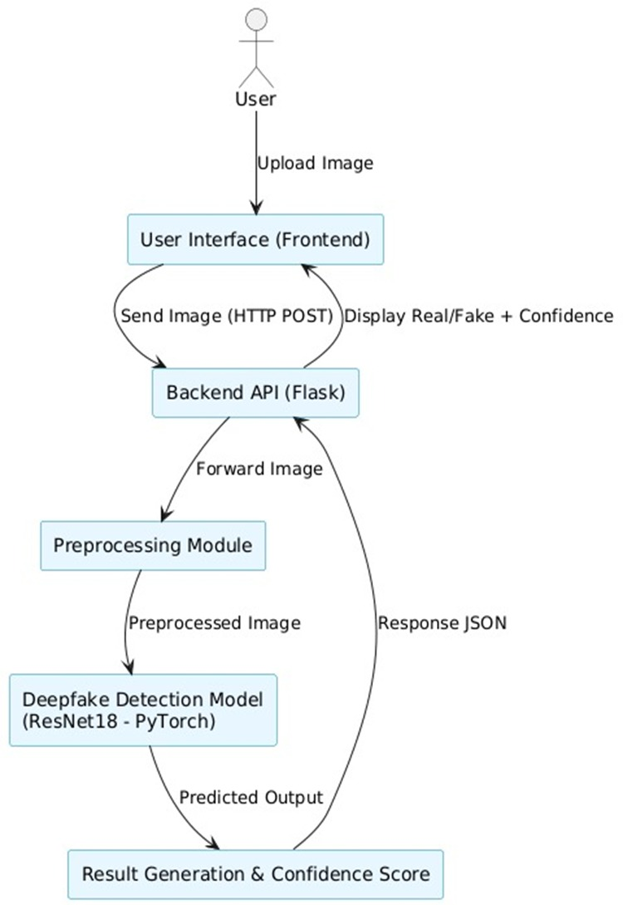
Slide Title
System Architecture
This system allows a user to upload an image through the frontend interface.
The image is sent to a Flask backend API, which forwards it to a preprocessing module.
After preprocessing, the image is passed into a Deepfake Detection Model (ResNet18 – PyTorch).
The model predicts whether the image is real or fake.
The backend then generates and sends the result back to the frontend, which displays the final output to the user.

Slide 6
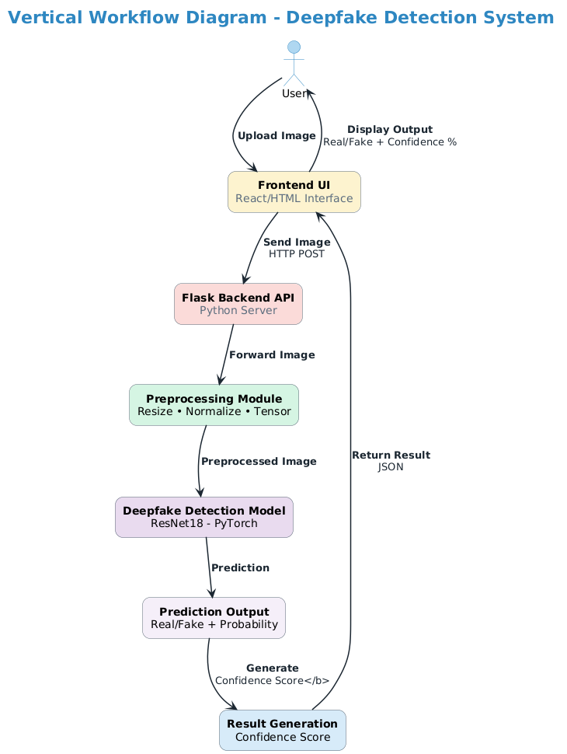
Slide Title
Work Flow

Slide 7
Slide Title
Technology
Programming & Libraries:
Language: Python 3.x
Deep Learning Libraries: PyTorch / TensorFlow (Keras), torchvision
Data Processing: OpenCV, NumPy Pandas, NumPy
Visualization: Matplotlib, Seaborn
Web Framework:
Flask for backend model deployment
HTML/CSS/JavaScript or React for frontend
Development Environment:
Jupyter Notebook for experimentation
Visual Studio Code for development
Google Colab for GPU acceleration
Dataset:
Source: FaceForensics++ (FF++) Deepfake Dataset
Real Videos:
Authentic face videos used for baseline training
Fake Videos:
AI-generated manipulated videos created using multiple deepfake techniques
Extracted Frames:
Individual face frames collected after Haarcascade detection for training, validation, and testing

Slide 8
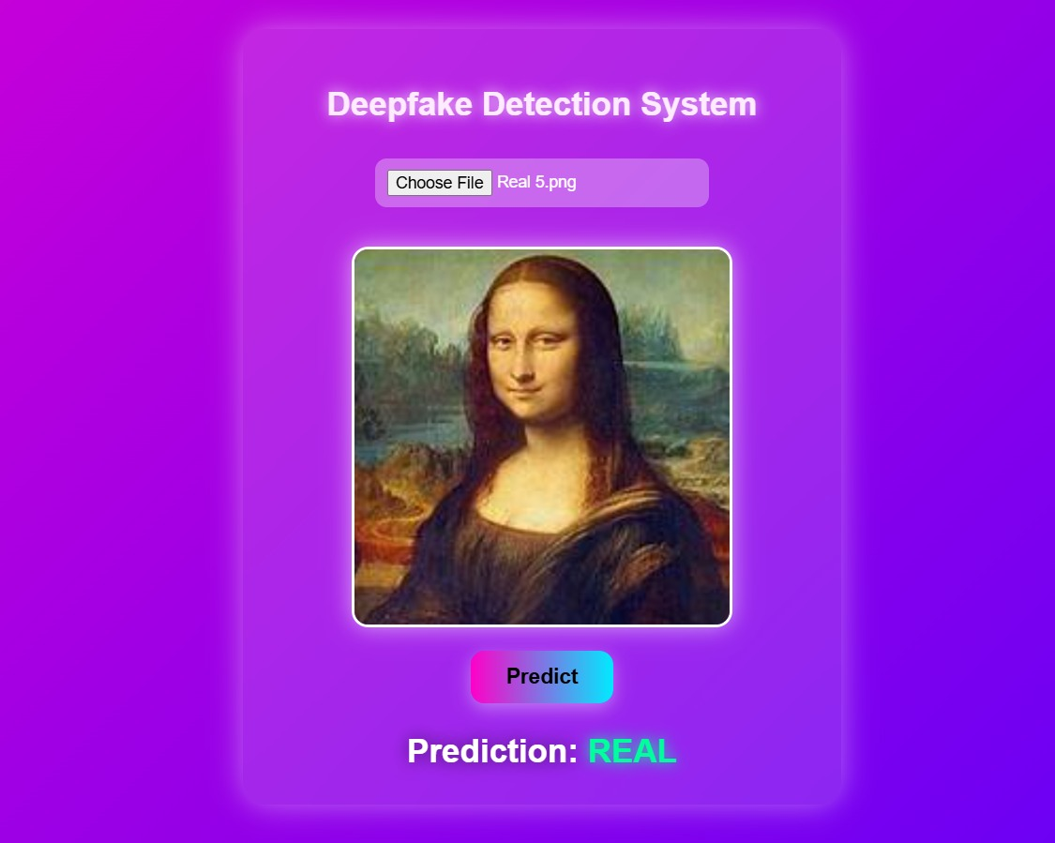
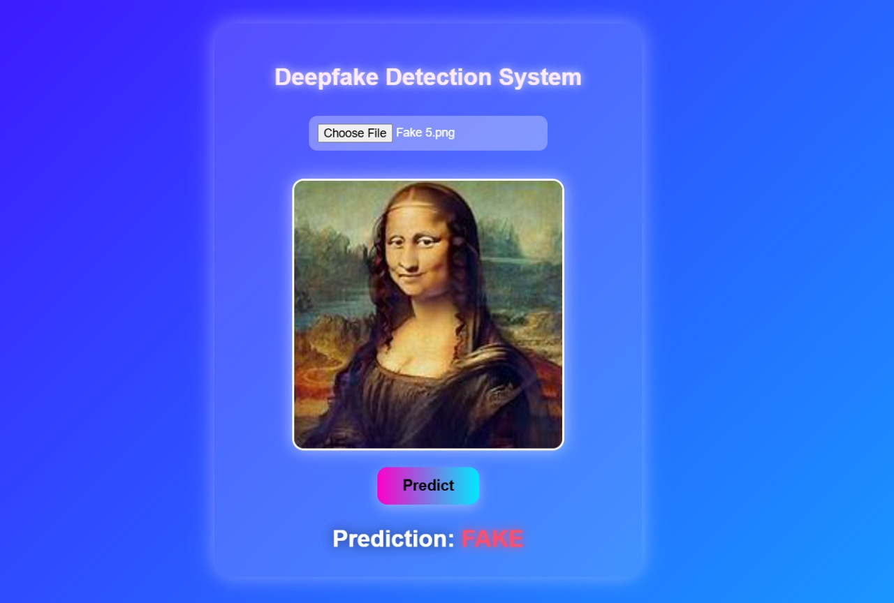
Slide Title
Results & Performance

Slide 9
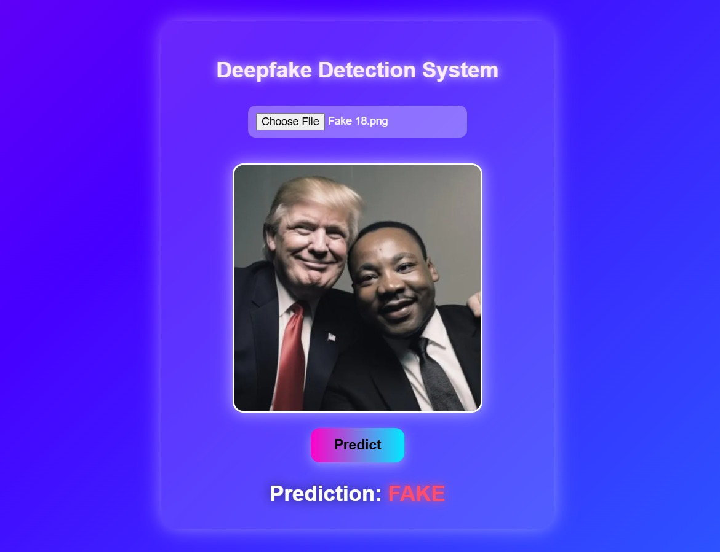
Slide Title
Results & Performance
System Interface & Visualizations
Dashboard Features:
1. Main Dashboard
Shows real vs fake results
Displays sample frames
Summary of model performance
2. Detection Module
Upload image/video
Instant real/fake prediction
3. Analysis Section
Displays detected frames
Confusion matrix & performance metrics
4. Report Generation
Downloadable prediction reports
View previous detection history

Slide 10
Slide Title
Conclusion
The project successfully implemented and evaluated a deep learning–based system for deepfake image detection.
Among all tested approaches, the ResNet18 transfer learning model achieved the best performance, delivering high accuracy and strong generalization in identifying manipulated facial content.
The results clearly demonstrate that deep learning models are highly effective in detecting subtle visual artifacts and inconsistencies found in deepfake media, outperforming traditional manual or rule-based methods.
The system provides accurate, reliable, and interpretable results, enabling users and organizations to make informed decisions when analyzing suspicious images or videos.
This work highlights the power of AI in safeguarding digital authenticity, helping to detect fake media, reduce misinformation, and protect user privacy.
With future enhancements such as real-time video stream detection, LSTM-based temporal analysis, and support for newly emerging deepfake techniques, the system can evolve into a comprehensive and intelligent deepfake detection platform.

Slide 11
Slide Title
References
Beshah, T., & Hill, S. (2010). Deepfake Media and Digital Misinformation: Challenges in Detecting Manipulated Content. AAAI Spring Symposium: Artificial Intelligence for Development.
Esmaeili, A., Khalili, M., & Pakgohar, A. (2012). Analysis of Facial Manipulation Artifacts Using Machine Learning Approaches. Proceedings of ICSSBE 2012, Langkawi, pp. 1–4.
Patel, S., Kumar, R., & Mehta, D. (2023). Deepfake Detection Using Deep Learning Techniques. IEEE Access, vol. 11, pp. 92340–92390.
Sharma, M., & Agarwal, K. (2023). Deepfake Image and Video Classification Using CNN and Transfer Learning Models. International Research Journal of Engineering and Technology (IRJET), vol. 10, no. 5, pp. 1145–1152.
Verma, R., Singh, P., & Chauhan, A. (2022). Deepfake Recognition Using Ensemble and Transfer Learning Models. International Journal of Computer Applications, vol. 184, no. 19, pp. 25–32.
Chollet, F. (2021). Deep Learning with Python. Manning Publications.
Dataset Source
📊 FaceForensics++ (FF++) Deepfake Dataset

Slide 12


